Slide 1
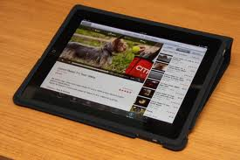
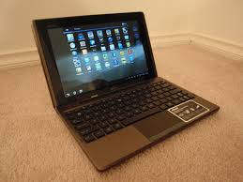
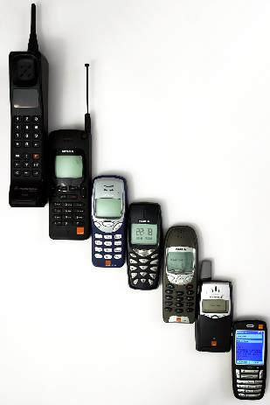
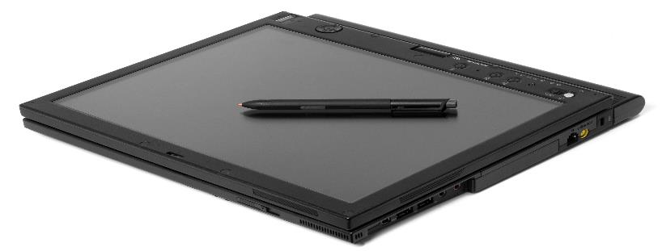
Mobile Applications
Hybrid or Native?!
Doncho Minkov
Senior Technical Trainer
http://minkov.it
Telerik Software Academy
http://academy.telerik.com

Slide 2
Table of Contents
Mobile applications overview
Devices and platforms
Android, iOS, Windows Phone, Firefox OS and more
Types of mobile applications
Web, Native and Hybrid applications Overview
Means for Hybrid applications development

Slide 3
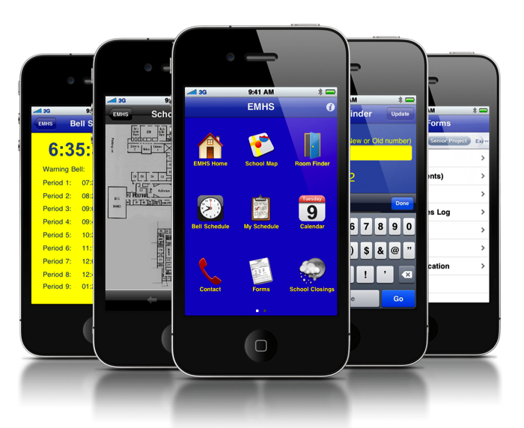
Mobile Applications

Slide 4
Mobile Applications
Mobile applications are software applications running on mobile devices
i.e. tablets, smartphones and other mobile devices
Mobile applications are often available through app distribution platforms (stores)
Apple App Store, Google Play, Windows Phone Store, BlackBerry App World, etc…

Slide 5
Mobile Platforms and Devices
The most prominent platforms are as follows:
Apple iOS
Microsoft Windows Phone 8 and Windows 8
Google Android
Firefox OS (yet to come)
BlackBerry OS
webOS by LG (formally product of HP)
Nokia Symbian OS
Samsung Bada (stopped from development)
Tizen by Intel and Samsung

Slide 6
Platforms Market Share 2013
As for Q2 2013 (August 2013) the market share of mobile platforms is as follows:
Operating System | Market Share by IDC | Market Share by Garthner
Android | ~79.3% | ~79.0%
iOS | ~13.2% | ~14.2%
Windows Phone | ~3.7% | ~3.3%
BlackBerry | ~2.9% | ~2.7%
Symbian | ~0.2% | ~0.3%
Other | ~0.8% | ~0.6%
Gartner numbers: http://www.gartner.com/newsroom/id/2573415
IDC numbers: http://www.idc.com/getdoc.jsp?containerId=prUS24257413

Slide 7

Mobile Applications Development

Slide 8
Mobile Applications Development
Each platform has its own development platform and tools
Windows Phone/Windows 8 – Visual Studio
Skills: C#, VB.NET or C++
Android – Eclipse and Android Dev tools
Skills: Java and/or C++
iOS and iOS mobile – xCode
Skills: Objective-C

Slide 9
Mobile Applications Development (2)
Each platform has its own development platform and tools
Firefox OS – Any text editor
Skills: Web, HTML and JavaScript
BlackBerry OS – QNX Momentics IDE
Java and/or C++
Symbian OS – Carbide.c++ or Eclipse Pulsar
Skills: C++ or Java

Slide 10
Mobile Applications Development
Operating System | Tools | Skills
Android | Eclipse and ADT | Java or C++
iOS | xCode | Objective-C
Windows Phone Windows 8 | Visual Studio | C#/VB or C++
BlackBerry OS | QNX Momentics | Java
Firefox OS | Text Editor | HTML/JavaScript
Symbian | Carbide.c++ or Eclipse Pulsar | C++ or Java

Slide 11
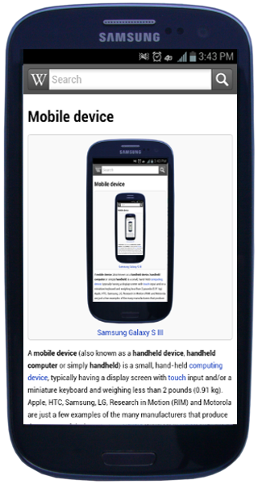
Types of Mobile Applications

Slide 12
Types of Mobile Apps
As the technology evolves, so does the power of Mobile apps
More and more companies introduce their own mobile apps
Three common types of applications
Web mobile applications
Native mobile applications
Hybrid mobile applications

Slide 13

Web Mobile Applications

Slide 14
Web Mobile Applications
Web mobile apps are not real applications
They are web sites that has the look and feel of a mobile app
Developed in any Web technology
ASP.NET, SPA application, PHP, Java, etc…
Web mobile apps run in the browser
Installed from an URL
They are actually a web site/application, working in chromeless browser

Slide 15
Web Mobile Applications (2)
For security reasons web mobile apps cannot use the full power of the mobile OS
APIs like Geolocation, File System and Camera are inaccessible
The users must explicitly confirm the access to some of the APIs, every time s/he opens the app
Web mobile application are most suitable for information applications and apps not using mobile functionality
Like a RSS application, news app

Slide 16
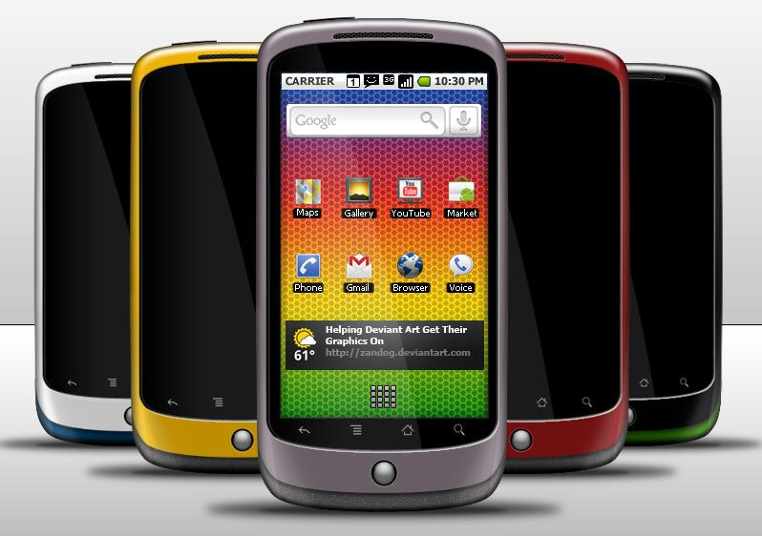
Native Mobile Applications

Slide 17
Native Applications
Native applications are applications developed for running on a specific OS
They run only on its operating system
Native apps must be installed either using an Application Store (Google Play, App Store) or through an external app installer

Slide 18
Native Applications (2)
Native apps have full access to resources of OS
Geolocation, File System, Accelerometer, etc.
The user must confirm the access to device APIs
Yet, only once, at the installation of the app
Native apps are developed on the platform and are hard to be ported to other platforms
iPhone apps with Objective-C
Android apps with Java
Windows Phone apps with C#

Slide 19
Native Applications (3)
Native apps are suitable when developing:
Games
The developer can use the device’s GPU
Apps with complex processing
The app must do a work of processing
Apps where 10 milliseconds slowdown is crucial

Slide 20
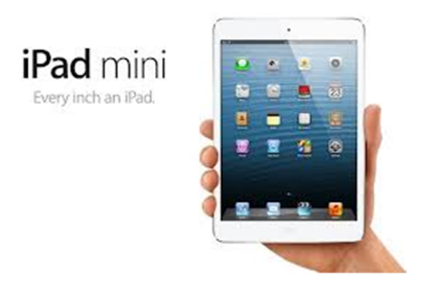
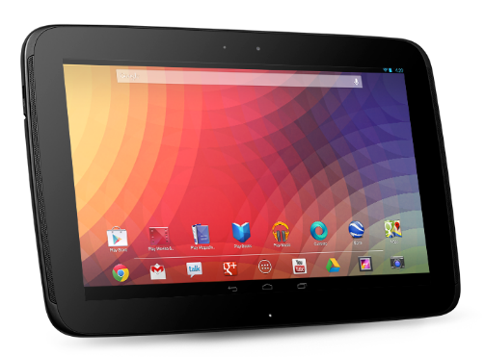
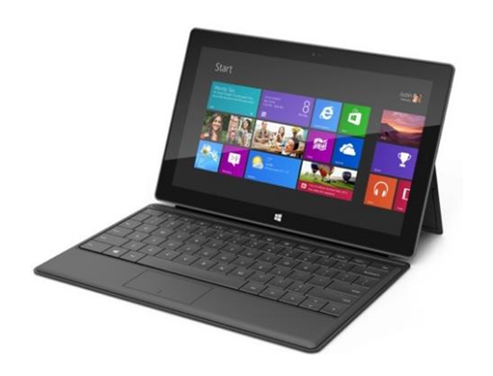
Hybrid Mobile Applications
Learning all Objective-C, Java and C# is not good enough?

Slide 21
Hybrid Applications
Hybrid apps are part native, part web apps
Yet they are neither
Also called cross-platform
Hybrid apps are like native apps
They can be published to an application store
They can be installed on the device
They can use the power of the device
Hybrid apps are like web apps
Coded in web technologies like HTML and JS

Slide 22
Hybrid Applications (2)
Hybrid applications leverage the engine of the default browsers for the platform
Safari mobile for iOS
Android browser for Android
IE9 mobile for Windows Phone 7
IE10 mobile for Windows Phone 8
The browser engine renders the HTML and process the JavaScript locally to the device
There is an abstraction layer, enabling the app to access device capabilities

Slide 23
Hybrid Applications Structure
Hybrid applications run in a native container on a mobile device
The native container uses the browser engine to run the app
UIWebView for iOS
WebView for Android
WebBrowser in Windows Phone 8
This enables the app to use the device capabilities

Slide 24
Hybrid Applications Structure (2)
Most of the default mobile browsers use WebKit rendering engine
That means iOS, Android, Blackberry, etc.
Windows Phone’s IE uses Trident engine
That is why most hybrid applications can be tested on simulators, not only on emulators

Slide 25


Hybrid Apps Platforms

Slide 26
Hybrid Apps Platforms
Since the rise of HTML5 (2010) more and more hybrid application platforms surfaced
Apache Cordova (late PhoneGap)
Appcelerator Titanium
Xamarin
And more
Most hybrid app platforms targeted web developers with JavaScript skills
Since HTML is supported everywhere

Slide 27
Apache Cordova
Apache Cordova (late PhoneGap) is a platform for creating mobile applications using web technologies
The applications run on the most used platforms
iOS, Android, BlackBerry, Windows Phone, etc…
Applications run in a web view
Apache Cordova was created by Nitobi Software, and was acquired by Adobe Systems in 2011

Slide 28
Appcelerator Titanium
Appcelerator Titanium is a product of Appcelerator Inc.
Use web technologies (like HTML and JS) to build cross-platform (hybrid) applications
Apps run on most platforms – Android, BlackBerry, iOS and Tizen
Applications run in a web view
Titanium has its own IDE, called Titatinum Studio and simulators

Slide 29
Xamarin
Xamarin is a cross-mobile applications platform
Yet, it does not use web technologies
Xamarin now continues the development of the Mono platform
Mono, MonoTouch, and Mono for Android
Applications are developed using C# and .NET like platform (Mono)
Apps run on iOS, Android and Windows Phone

Slide 30
Mobile Applications
http://academy.telerik.com

